Slide 1

INT 217 PROJECT
TOPIC:- SALES DASHBOARD
BY :- SIDDHANT GAURAV
REG. NO:- 11903087

Slide 2
DECLARATION
I, Siddhant Gaurav, student of Lovely Professional University under CSE/IT Discipline at, Lovely Professional University, Punjab, hereby declare that all the information furnished in this assignment is based on my own intensive work and is genuine.

Slide 3
ACNOWLEDGEMENT
A project work is a combination of views, ideas, suggestions and contribution of many people. I consider it as great privilege to have esteemed Lecturer Ms. Ashu as my project guide. I take this opportunity to express my sincere gratitude to her through constant advice and constructive criticism nourished my interest in the subject and provided a free and pleasant atmosphere to work against all odd situations.

Slide 4
INTRODUCTION
A document in which information is collected in a systematic manner for a specific purpose is known as a sales report. It may contain the following information like Details of the salesperson and the company, Details of the customer or prospects, Details about products sold, Response to the products, Date and time of making the report, Cost of goods sold. A sales report is an analytical tool that provides insights into the performance of various sales activities within a company. Armed with powerful visualizations, sales teams use these reports to find trends and patterns to improve their service and ensure sales growth
These reports help in finding potential new market opportunities where they could improve the results by using modern sales reporting software. They can be of various forms: a daily sales report format, weekly, monthly, yearly. These sales report format will provide a bigger picture of the activity of each sales representative on the basis of region(country), brand, industry, sales and revenue generated by each representative.
Putting it all together on sales dashboard will enable you to automate your data , make your data dynamic, interactive and focus on human-centric tasks, without the need for time-consuming manual calculations and repetitive exports

Slide 5
OBJECTIVES
The main idea of this project is to cover and achieve seven objectives given below: -
Sales representative performance on the basis of sales value (sum &count of sales value)
Sales representative performance on the basis of revenue
Sales by country
Sales by Brand
Sales & Revenue by sales channels
Sales by Industry
Revenue by Brand

Slide 6
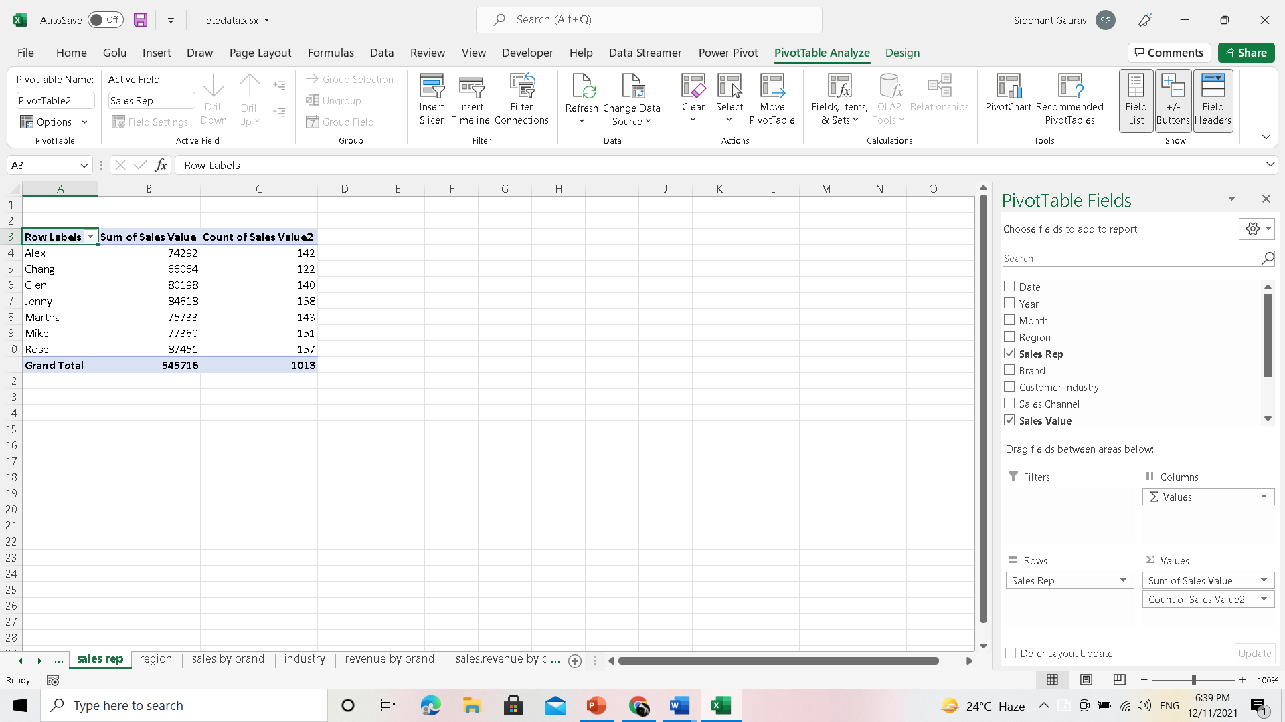
ANALYSIS ON DATASET

Slide 7
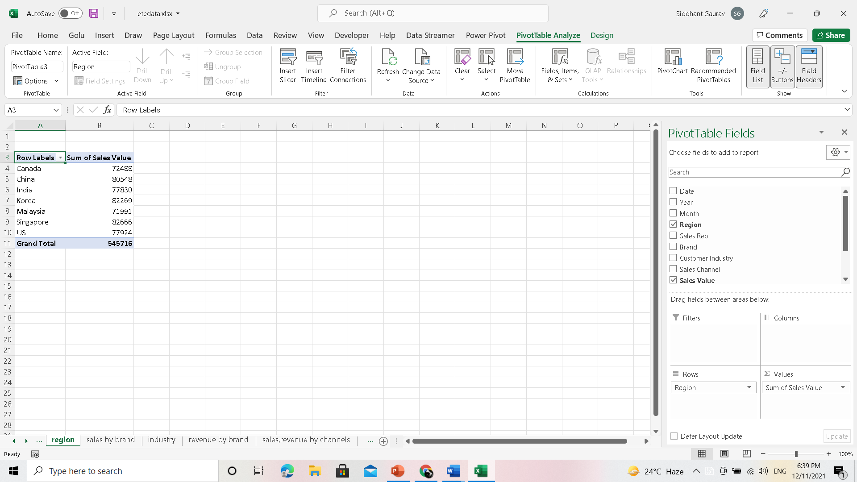
SALES BY REGION(COUNTRY)

Slide 8
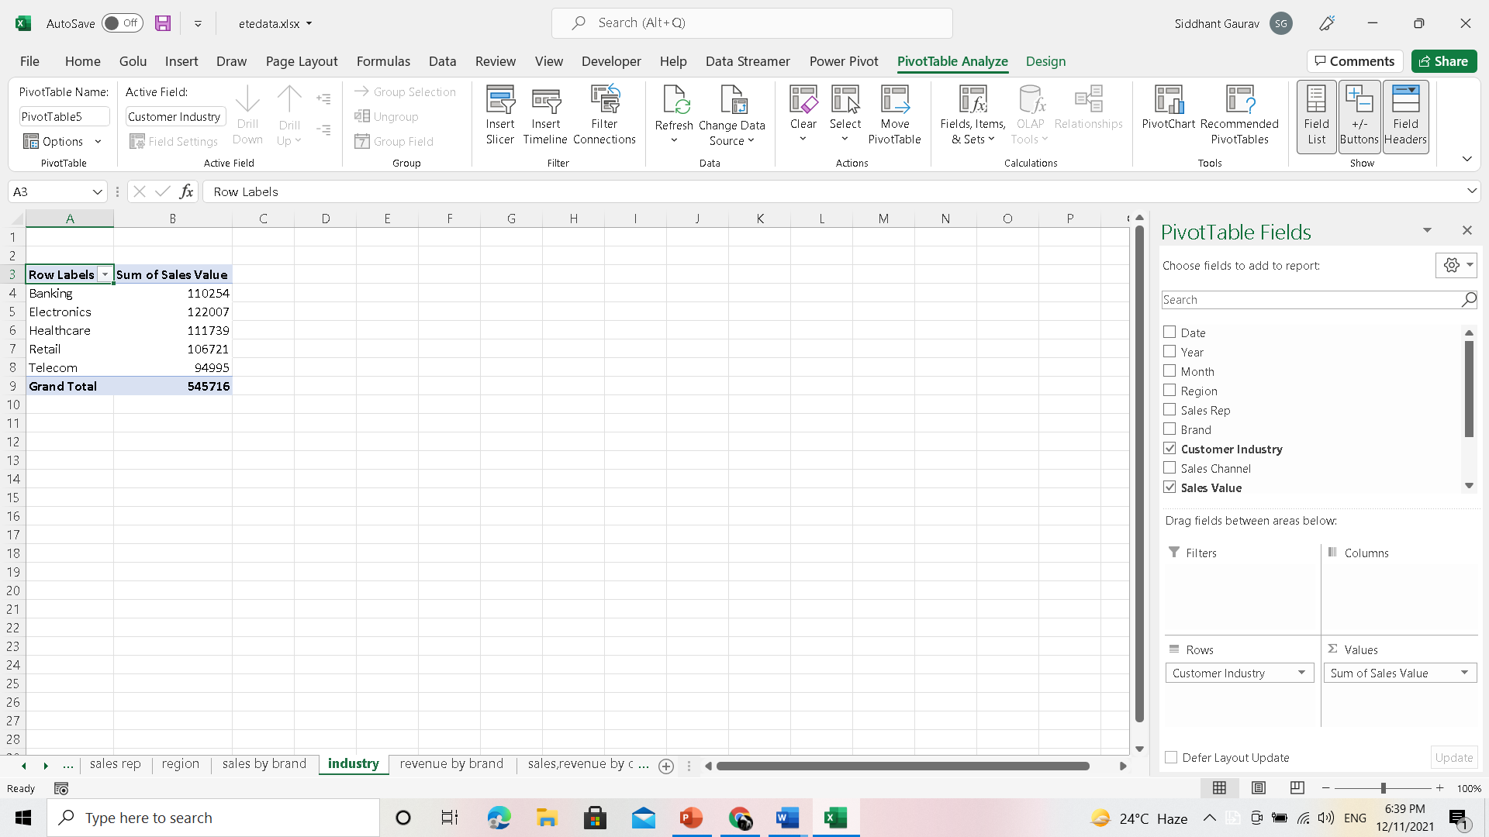
SALES BY INDUSTRY

Slide 9
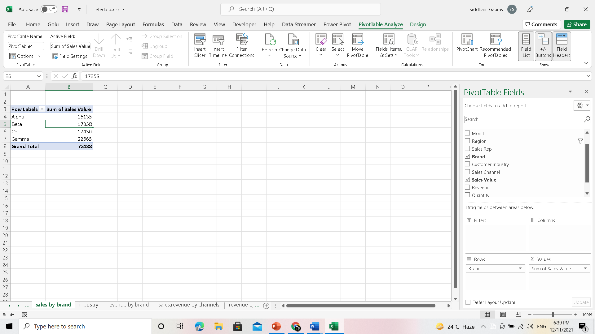
SALES BY BRAND

Slide 10
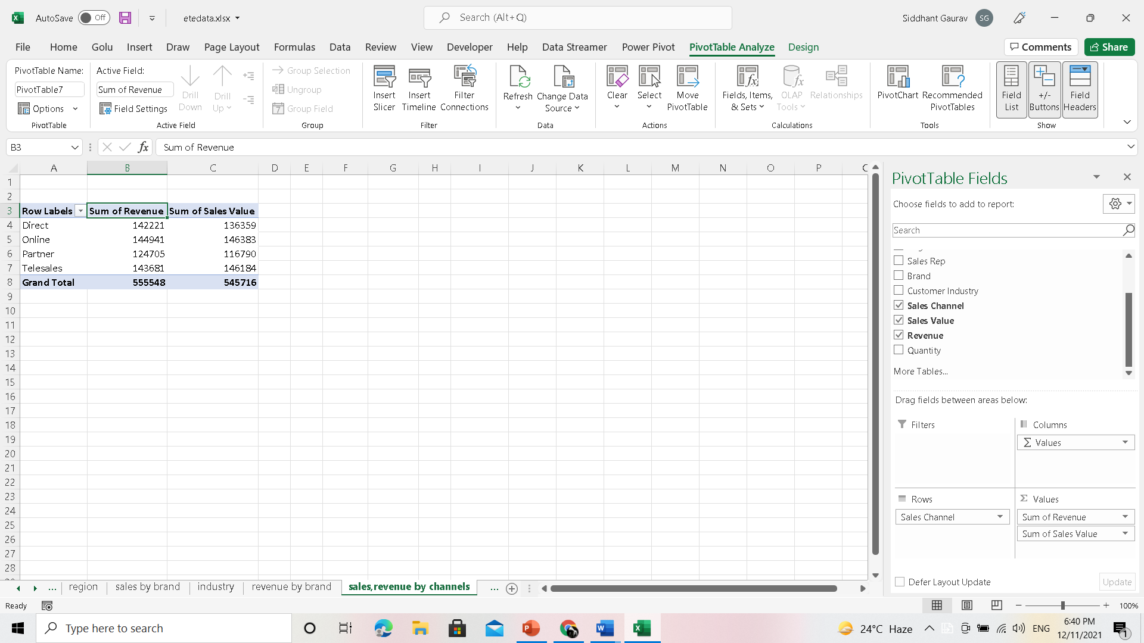
REVENUE & SALES BY SALES CHANNELS

Slide 11
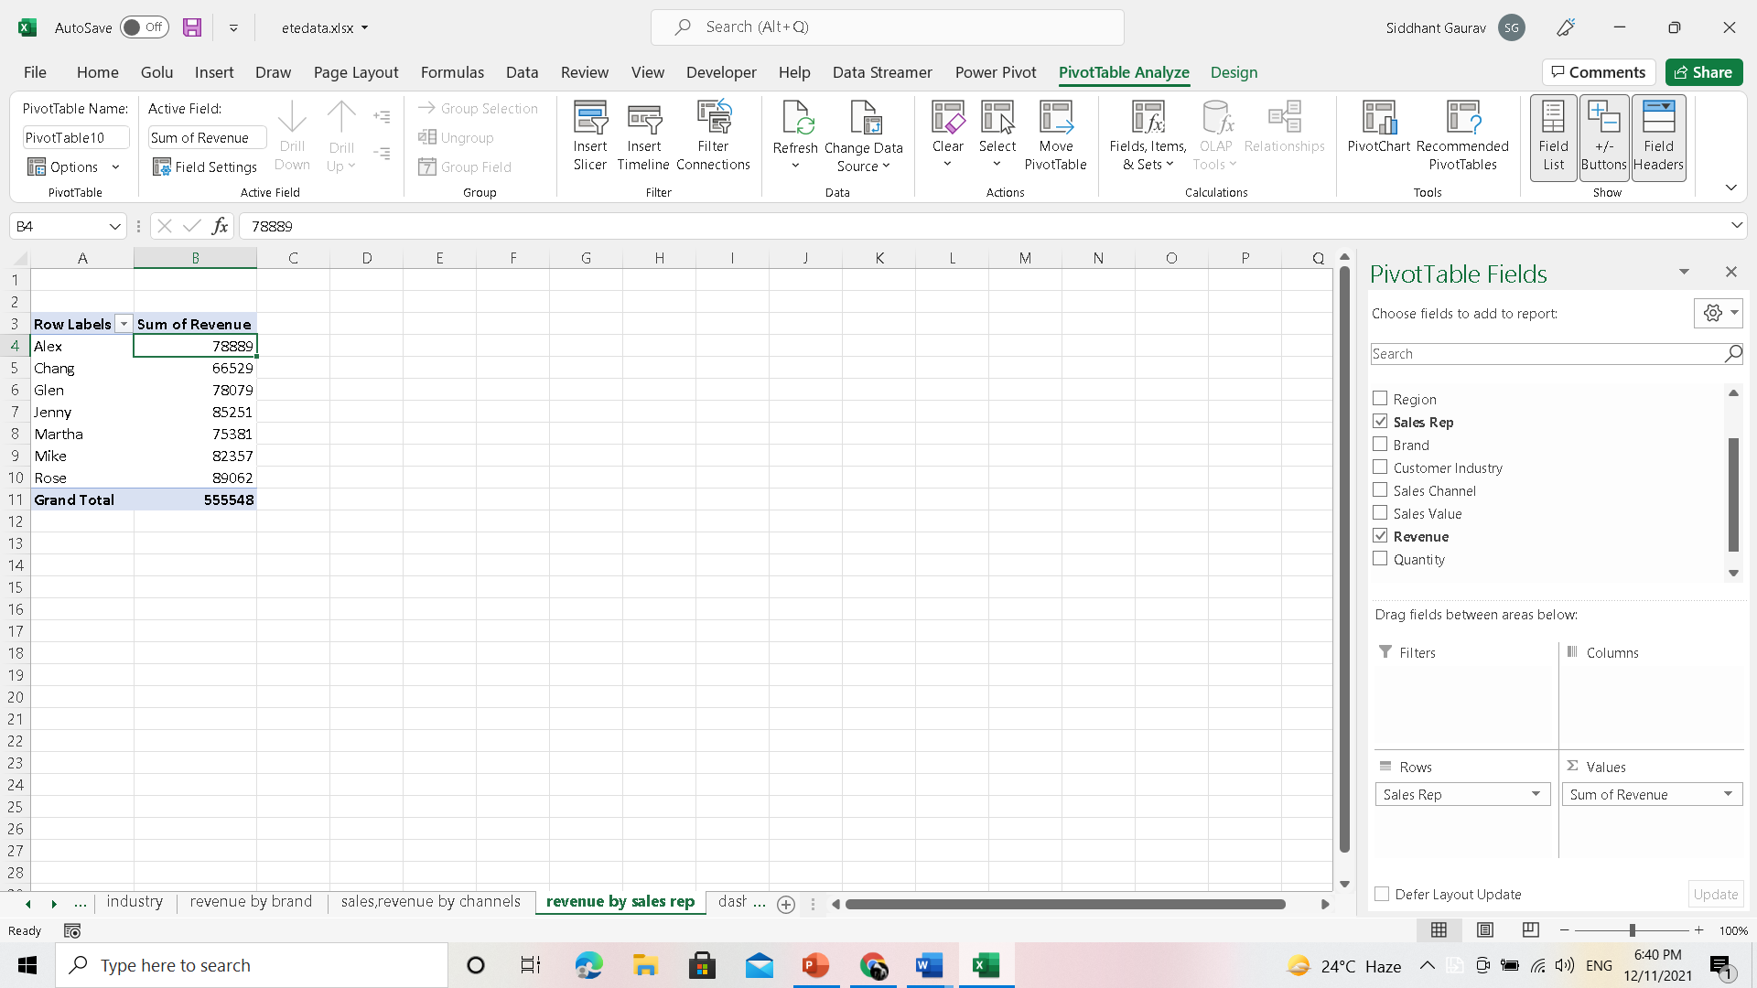
REVENUE BY SALES REPRESENTATIVE

Slide 12
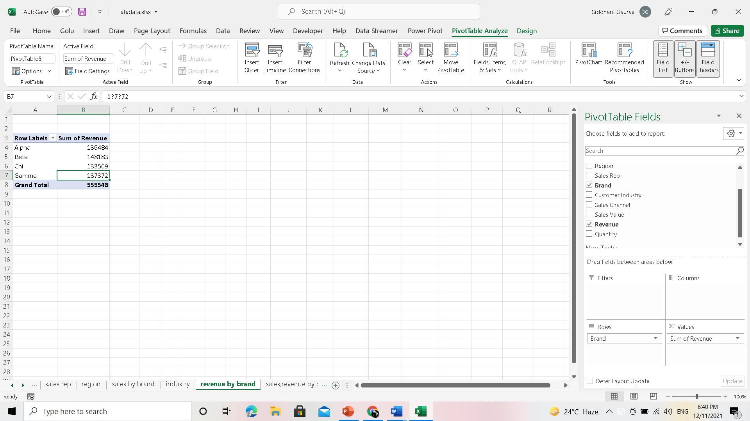
REVENUE BY BRAND

Slide 13
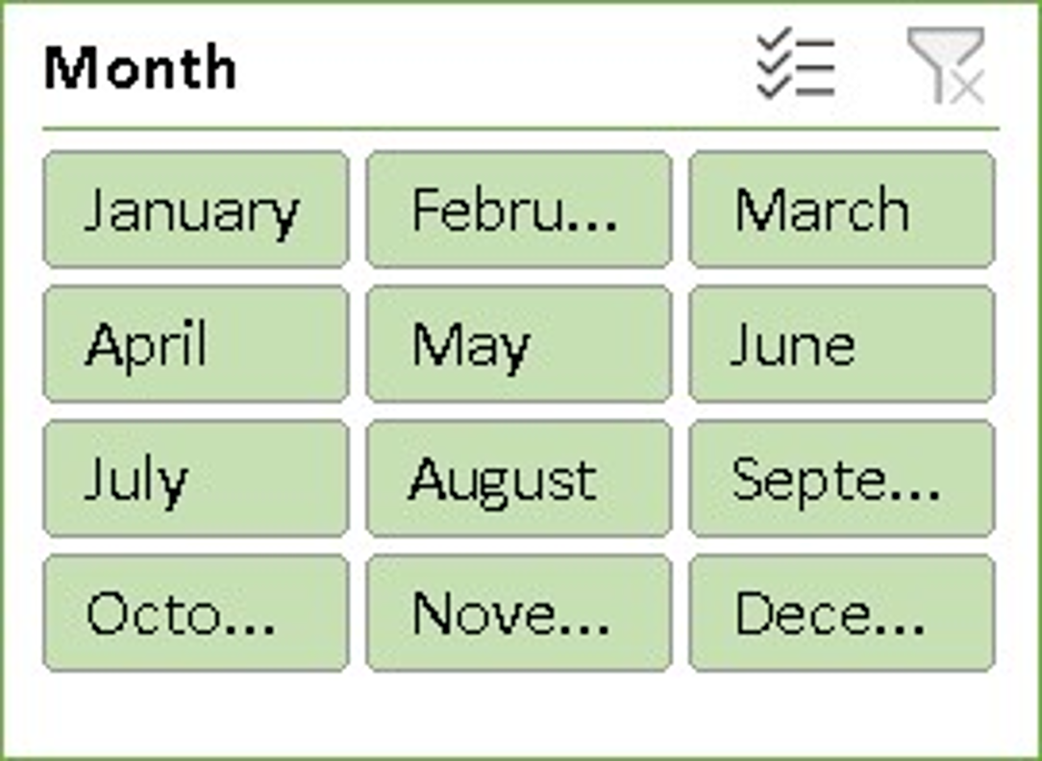
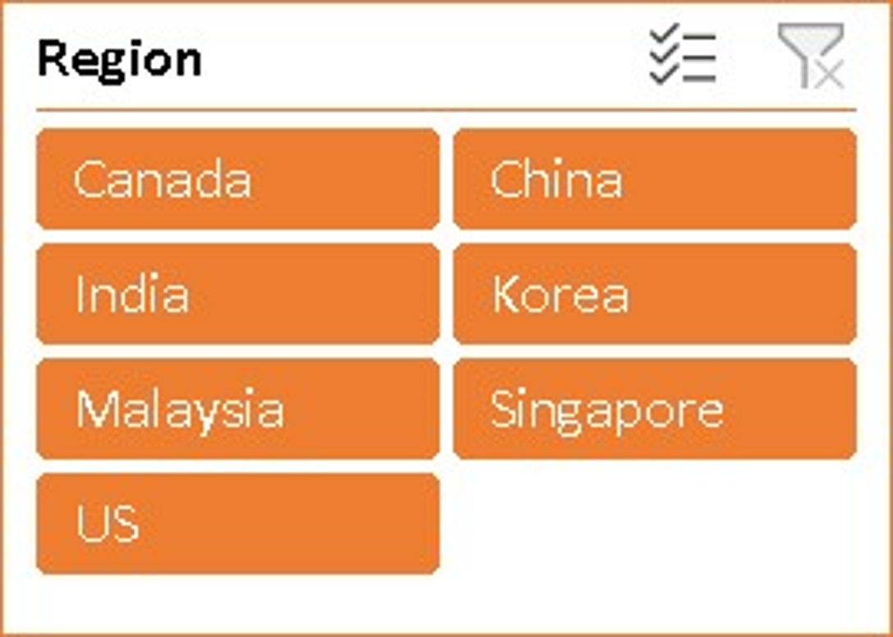
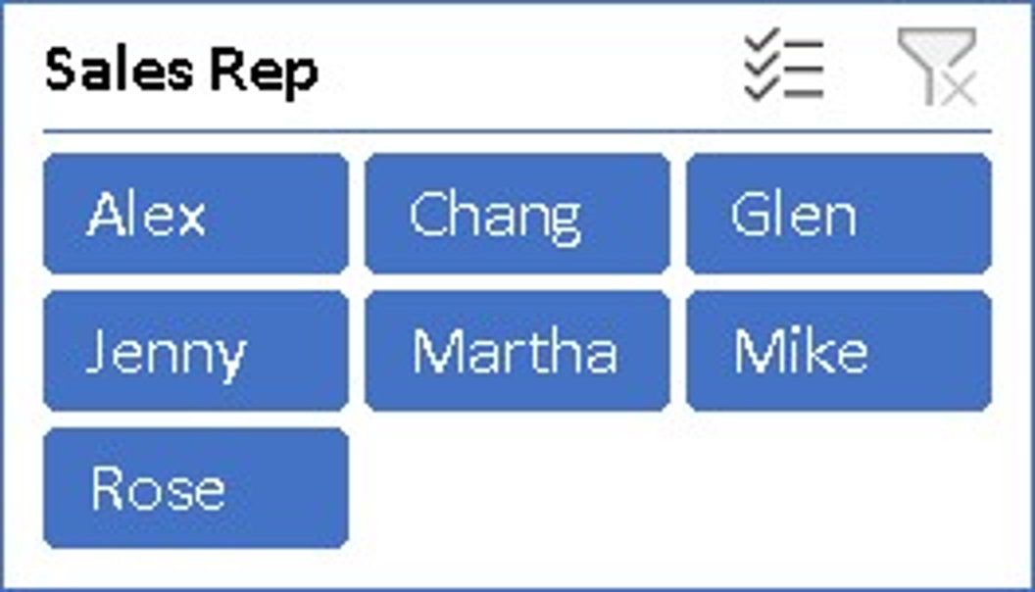
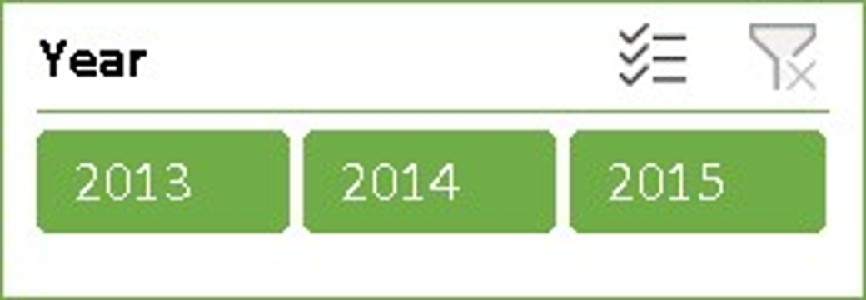
Slicers used in this project

Slide 14
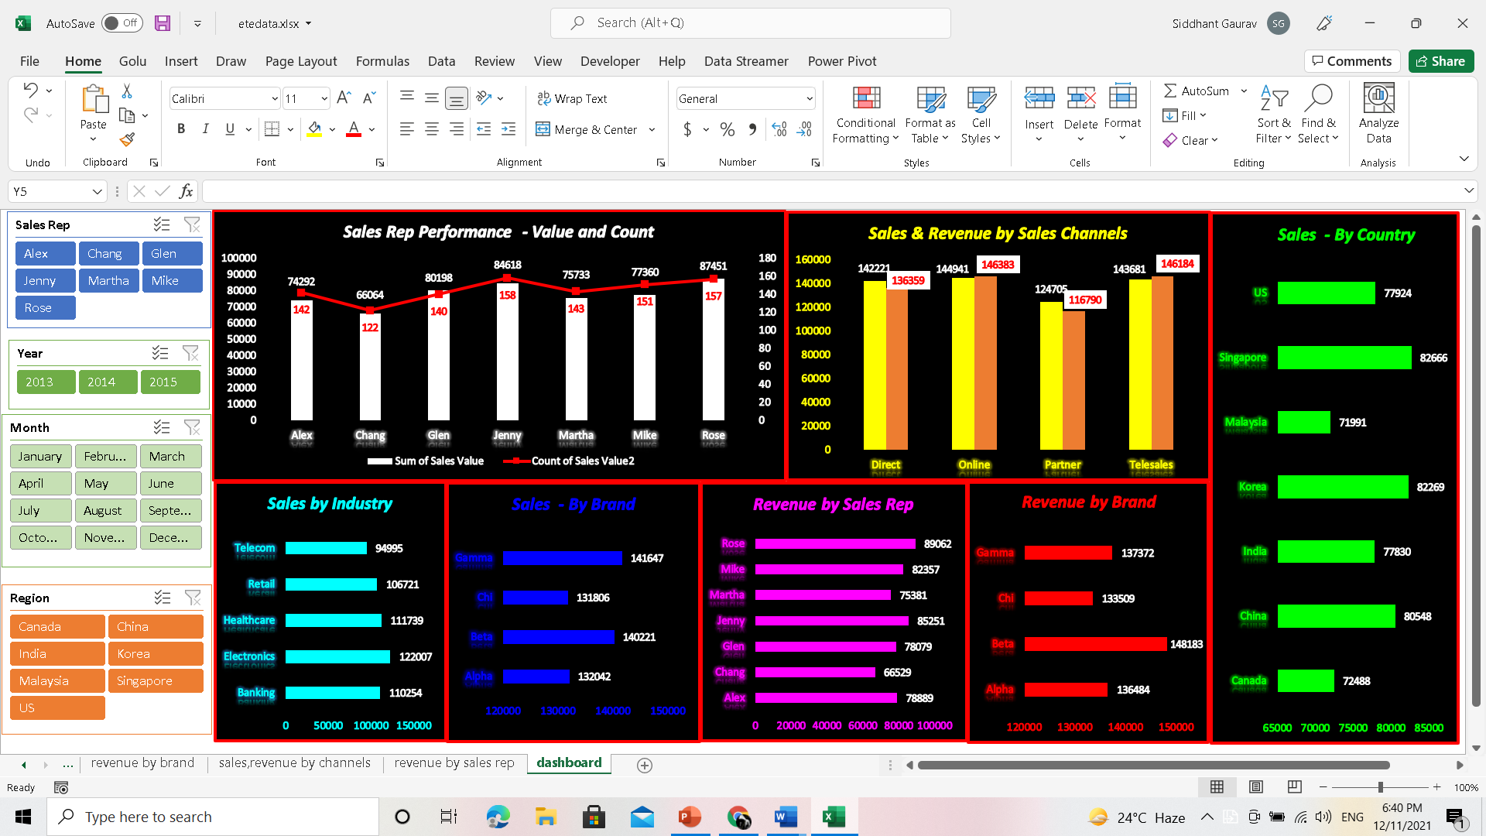
Sales dashboard

Slide 15
List of analysis with results
As we can see from the results , graph and dashboard that :-
Rose has done the maximum sales and Alex has done the minimum sales in both sales value and count of sales.
Electronics Industry has done the maximum sales and Telecom industry has done the minimum sales in terms of sales value.
Gamma Brand has done the maximum sales and Chi Brand has done the minimum sales in terms of sales value.
Beta Brand has generated the maximum revenue and Chi Brand has generated the minimum revenue as per sale.
Singapore country has given the maximum sales and Malaysia country has given the minimum sale.
Rose has generated the maximum revenue and Chang has generated the minimum revenue.
Online channel has generated the maximum sales and revenue and Partner channel has generated the minimum sales and revenue.

Slide 16
conclusion
Now we can conclude from the Dashboards and the graphs that Rose has done the maximum sales and Alex has done the minimum sales in both sales value and count of sales by country, by sales channels, by year, by month, by revenue, by industry, by brand.

Slide 17
Learning outcomes
I have learnt how to make an interactive dashboards using slicers, and pivot tables.
I have also learnt how to prepare reports, dashboards on the basis of sales by sale representative ,by industry, by brand, by country, by channels year wise and month wise as per the requirements.

Slide 18
references
Google
Youtube
https://trumpexcel.com

Slide 19
bibliography
https://trumpexcel. com
Google
Youtube

Slide 20
THANK YOU ☺

